Slide 1
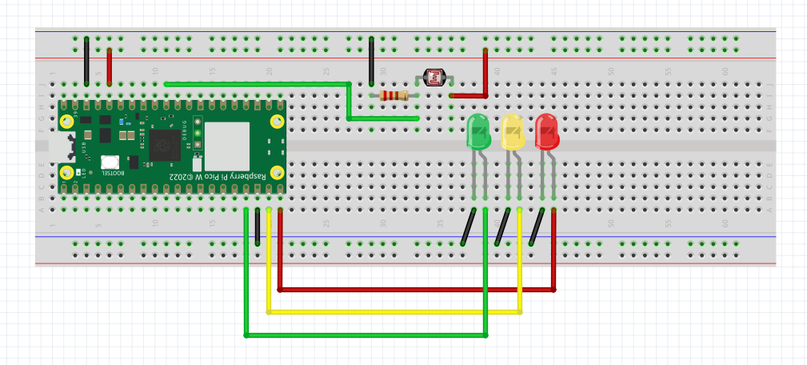
Demostration of how LDR works
LDR
10k
Voltage divider

